Slide 1
Business English in Presentation
By Islam Lotfy

Slide 2
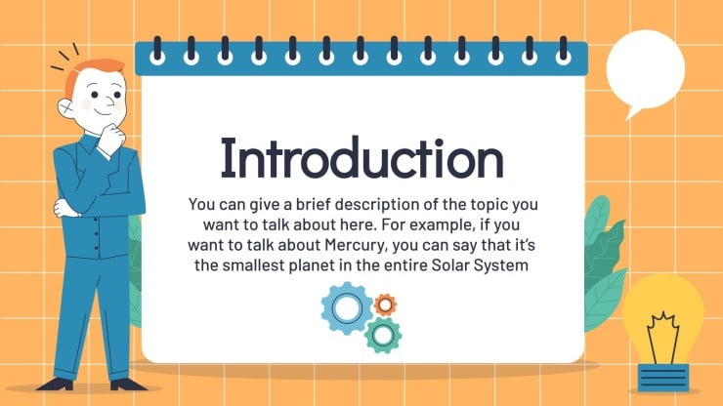
Our agenda
Introduction to business English in presentation
Steps for delivering a good presentation for teaching method and students
How to a good presenter
How to perform opening the presentation well
How to perform closing the presentation well
Questions

Slide 3
Effective communication is becoming essential in business presentations for students and the general public and how to deliver the presentation in a business setting.
Teaching methods like setting the context, explaining the good definition, discussing things to be prepared, discussing the past experience, and concluding the context activity.
Students’ activities like recalling background information, listening to the presentations, taking notes, having discussions about being a good presenter, working in pairs to answer some questions related to delivering a presentation, and giving opinions and insights.
A Good presenter should be prepared “make sure everything ”, believe in yourself, and prepare the material well, rooms, and seating. in addition to taking your time and organizing time, connecting to your audience, and being flexible and adjusting.
Not boring introduction powerful statements and using visual charts.
Opening the presentation well like a good greeting to the audience knowing your audience is very important because it gives the first impression and also purpose and relevant topic. For example, “I’ll be showing”, and “I’d like to bring”.
Creative opening is very important since it focuses on interest to build the audience’s confidence to share their ideas and thoughts through questions, surveys, and stories.
Time of presentation.
Moving on and starting to another point.
Closing presentation with a powerful statement.

Slide 4

Questions

